Slide 1
Unit 1
Getting Started Docker
Docker is a very powerful containerization platform – not to mention very popular. It is used extensively and provides a large number of integrations, including GitHub, Jenkins, Kubernetes and Terraform. We will be exploring the concepts and how best we can leverage Docker.

Slide 2
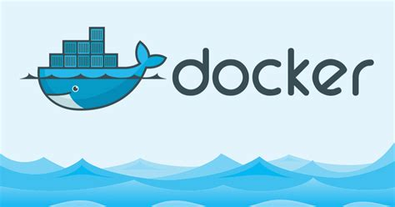
Why do we need Docker?

Slide 3
Shipping Transportation Challenges
Problem
When goods are transported, they have to pass through a variety of different means Ex:- trucks, forklifts, cranes, trains, and ships.
These means have to be able to handle a wide variety of goods of different sizes and with different requirements e.g. sacks of coffee, drums of hazardous chemicals, boxes of electronic goods, fleets of luxury cars, and racks of refrigerated lamb).
This was a cumbersome and costly process, requiring manual labor, such as dock workers, to load and unload items by hand at each transit point

Slide 4
Shipping Transportation Challenges
Solution
The transport industry was revolutionized by the introduction of the intermodal container.
These containers come in standard sizes and are designed to be moved between modes of transport with a minimum of manual labor.
Advantages :
All transport machinery is designed to handle these containers, from the forklifts and cranes to the trucks, trains, and ships.
For Ex :- Refrigerated and insulated containers are available for transporting temperature sensitive goods, such as food and pharmaceuticals.
The benefits of standardization also extend to other supporting systems, such as the labeling and sealing of containers.
This means the transport industry can let the producers of goods worry about the contents of the containers so that it can focus on the movement and storage of the containers themselves.

Slide 5
Relevance in IT Industry
Current IT Industry Problem :
We have a similar issue to the one seen by the transport industry—we have to continually invest substantial manual effort to move code between environments.
A typical modern system may include Javascript frameworks, NoSQL databases, message queues, REST APIs, and backends all written in a variety of programming languages
This stack has to run partly or completely on top of a variety of hardware—from the developer’s laptop and the in-house testing cluster to the production cloud provider.

Slide 6
Relevance in IT Industry
Solution
Much as the intermodal containers simplified the transportation of goods, Docker containers simplify the transportation of software applications.
Developers can concentrate on building the application and shipping it through testing and production without worrying about differences in environment and dependencies.
Operations can focus on the core issues of running containers, such as allocating resources, starting and stopping containers, and migrating them between servers.

Slide 7
How Does Docker Fit Into Devops Eco-System
Docker forms a lethal combination with Jenkins:
The lethal combination of Jenkins and Docker is proving to be very valuable for DevOps teams.
By leveraging the tight integration with source code control mechanisms such as Git, Jenkins can initiate a build process each time a developer commits his code. This process results in a new Docker image which is instantly available across environments.
Organizations are deploying private Docker registries to publish and maintain their internal Docker images
Docker makes it easier to test exactly what you deploy:
Docker containers encourage a central tenet of continuous delivery – reuse the same binaries at each step of the pipeline to ensure no errors are introduced in the build process itself. The complexities of the configuration Management tools are considerable and complicated to manage. Most of the problems stem from complex integrations.
Example: You have to make sure that you are using the same libraries and other important elements every time.
Making sure that all those environments are perfectly aligned can be a lot of work.
Docker solves that because you are starting with a given base image, and it’s guaranteed to be the same image everywhere.

Slide 8
How Does Docker Fit Into Devops Eco-System
Docker has revolutionized software packaging and deployment:
Instead of deploying the final set of artifacts such as EXE and JAR files to the target environment, ops teams are now packaging the entire application as a Docker Image.
This image shares the same build version before getting published to a central registry.
It is then picked up by various environments – development, testing, staging, and production – for final deployment
Docker containers provide the basis for immutable infrastructure:
Applications can be added, removed, cloned and/or its constituencies can change, without leaving any residues behind. Whatever mess a failed deployment can cause is constrained within the container.
Deleting and adding become so much easier that you stop thinking about how to update the state of a running application.

Slide 9
What is Docker ?

Slide 10

Docker
Docker is a Containerization platform which packages your application and all its dependencies together in the form of Containers so as to ensure that your application works seamlessly in any environment be it Development or Test or Production.
Container 1
Container 2
App 1
App 2
BINS / LIBS
BINS / LIBS
Docker Engine
Host OS

Slide 11
Containers v/s Virtual Machines

Slide 12
Virtualization; Adopted By VMs
Virtualization Technique
App 1
App 2
App 3
Advantages
BINS & LIBS
BINS & LIBS
BINS & LIBS
Multiple OS In Same Machine
Easy Maintenance & Recovery
Lower Total Cost Of Ownership
VMs
Guest OS
Guest OS
Guest OS
Disadvantages
Multiple VMs Lead To Unstable Performance
Hypervisors Are Not As Efficient As Host OS
Long Boot-Up Process ( Approx. 1 Minute )
Hypervisor
Host OS

Slide 13
Containerization
Note: Containerization Is Just Virtualization At The OS Level
Containerization Technique
App 1
App 2
App 3
Advantages Over Virtualization
Containers
BINS & LIBS
BINS & LIBS
BINS & LIBS
Containers On Same OS Kernel Are Lighter & Smaller
Better Resource Utilization Compared To VMs
Short Boot-Up Process ( 1/20th of a second )
Container Engine
Host OS

Slide 14
Benefits of Docker over VM’s

Slide 15
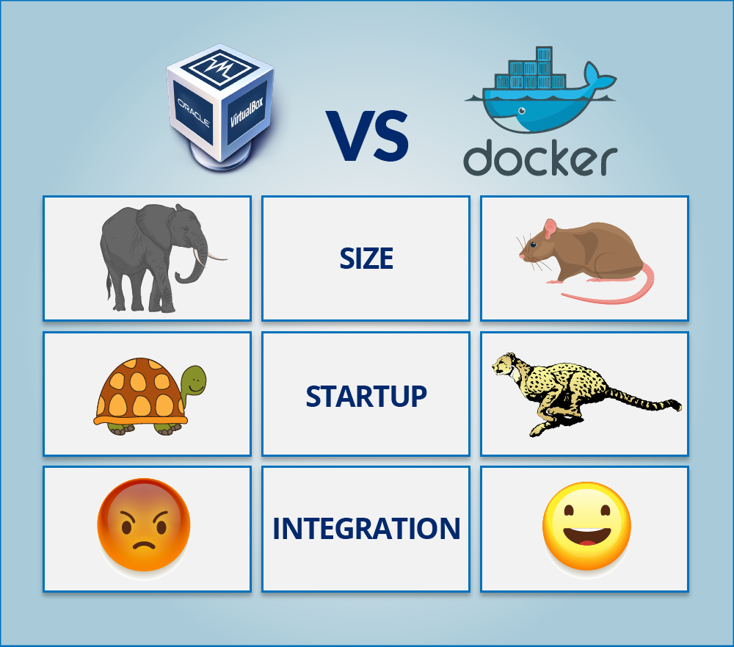
VM vs. Docker

Slide 16
Resource/Memory Utilization
In case of Virtual Machines
Total Memory:
16 GB
6 GB
4 GB
2 GB
VM 1
Size
4 GB
3 GB
1 GB
VM 2
Start-up
Integration
6 GB
2 GB
4 GB
VM 3
→
Memory Used: 9 GB
→
Memory wasted: 7 GB
7 Gb of Memory is blocked and cannot be allotted to a new VM

Slide 17
Resource/Memory Utilization
In case of Virtual Machines
In case of Docker
Memory Allotted: 4 GB
4 GB
App 1
Total Memory:
16 GB
6 GB
4 GB
2 GB
VM 1
Total Memory:
16 GB
Size
4 GB
Memory Allotted: 35 GB
Start-up
3 GB
1 GB
VM 2
3 GB
App 2
Integration
6 GB
2 GB
4 GB
VM 3
Memory Allotted: 10 GB
2 GB
App 3
→
Memory Used: 9 GB
→
Memory wasted: 7 GB
→
Memory Used: 9 GB
7 Gb of Memory is blocked and cannot be allotted to a new VM
Only 9 GB memory utilized; 7 GB can be allotted to a new Container

Slide 18
Building and Deployment
In case of Virtual Machines
In case of Docker
Build 1
Build 2
Ruby v1
Ruby v2
Build 1
Build 2
BINS & LIBS
BINS & LIBS
Ruby v1
Ruby v2
Size
Virtual Machines
BINS & LIBS
BINS & LIBS
Container
Start-up
Guest OS
Guest OS
Integration
Host OS Kernel
Host OS Kernel
New Builds → Multiple OS → Separate Libraries → Heavy → More Time
New Builds → Same OS → Separate Libraries → Lightweight → Less Time

Slide 19


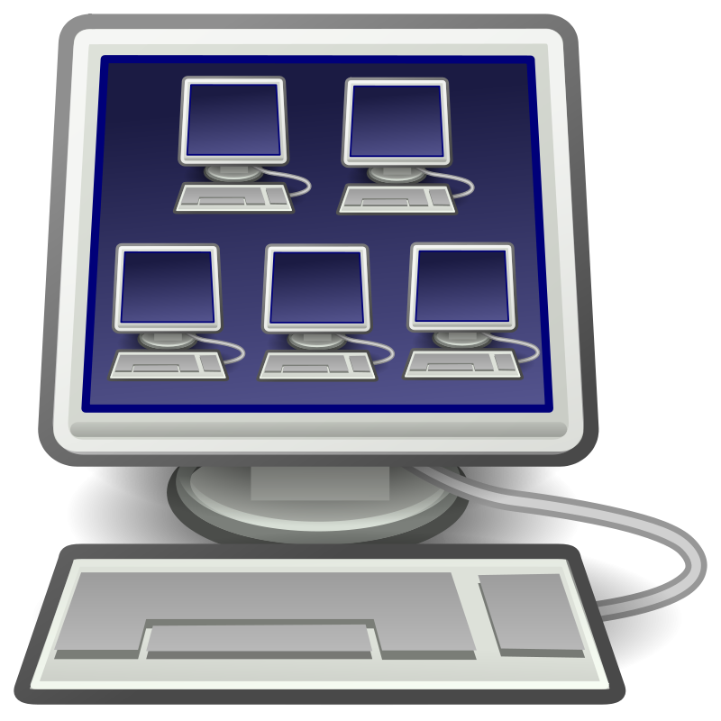


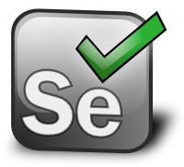

Integration in VMs
Integration In Virtual Machines Is Possible, But:
Costly Due To Infrastructure Requirements
Not Easily Scalable
Size
Start-up
Jenkins
Integration

Slide 20
When to use what?
Containers allow you to run more applications on a physical machine than VMs.
If resources are a constraint, containers may be a better choice.
With containers you can create a portable, consistent operating environment for development, testing, and deployment.
From a security viewpoint, important subsystems like SELINUX are outside the scope of containers
therefore a person with super user privileges in a container can in theory undermine underlying operating system.
There is no easy way to make a packaged box handle all upstream dependencies.
Wrong packaging is harder to debug and resolve, thus increasing time spent in QA activities.

Slide 21
When to use what?
What is the scope of your work? In our example, we have only Jenkins.
If we needed to run other applications, it makes more sense to use a VM over a container.
Do you plan to use this instance of Jenkins only on one OS? If yes, proceed with a container over a VM.
The thumb rules are
If planning to use multiple instances of an application over minimum number of servers, containers are the best options.
If planning to run multiple applications with greater requirement for security, then use VM.
In all cases, a proper Cost Benefit Analysis process is required to decide which option is best for your organization.

Slide 22
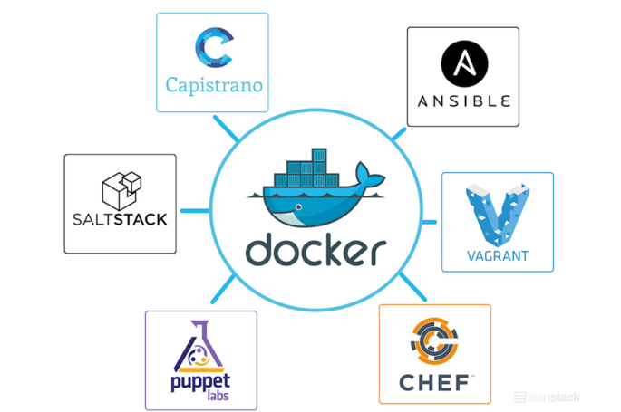

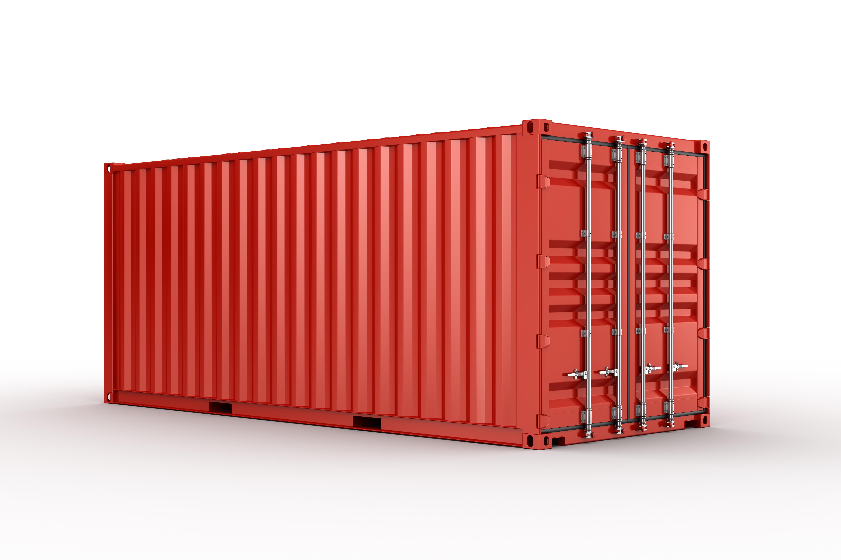
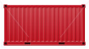
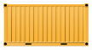
Docker – A DevOps Ally
Integration in Docker is Faster, Cheap & Easily Scalable
Jenkins
Size
Start-up
Integration

Slide 23
Architecture

Slide 24
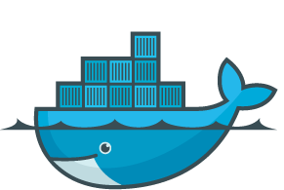


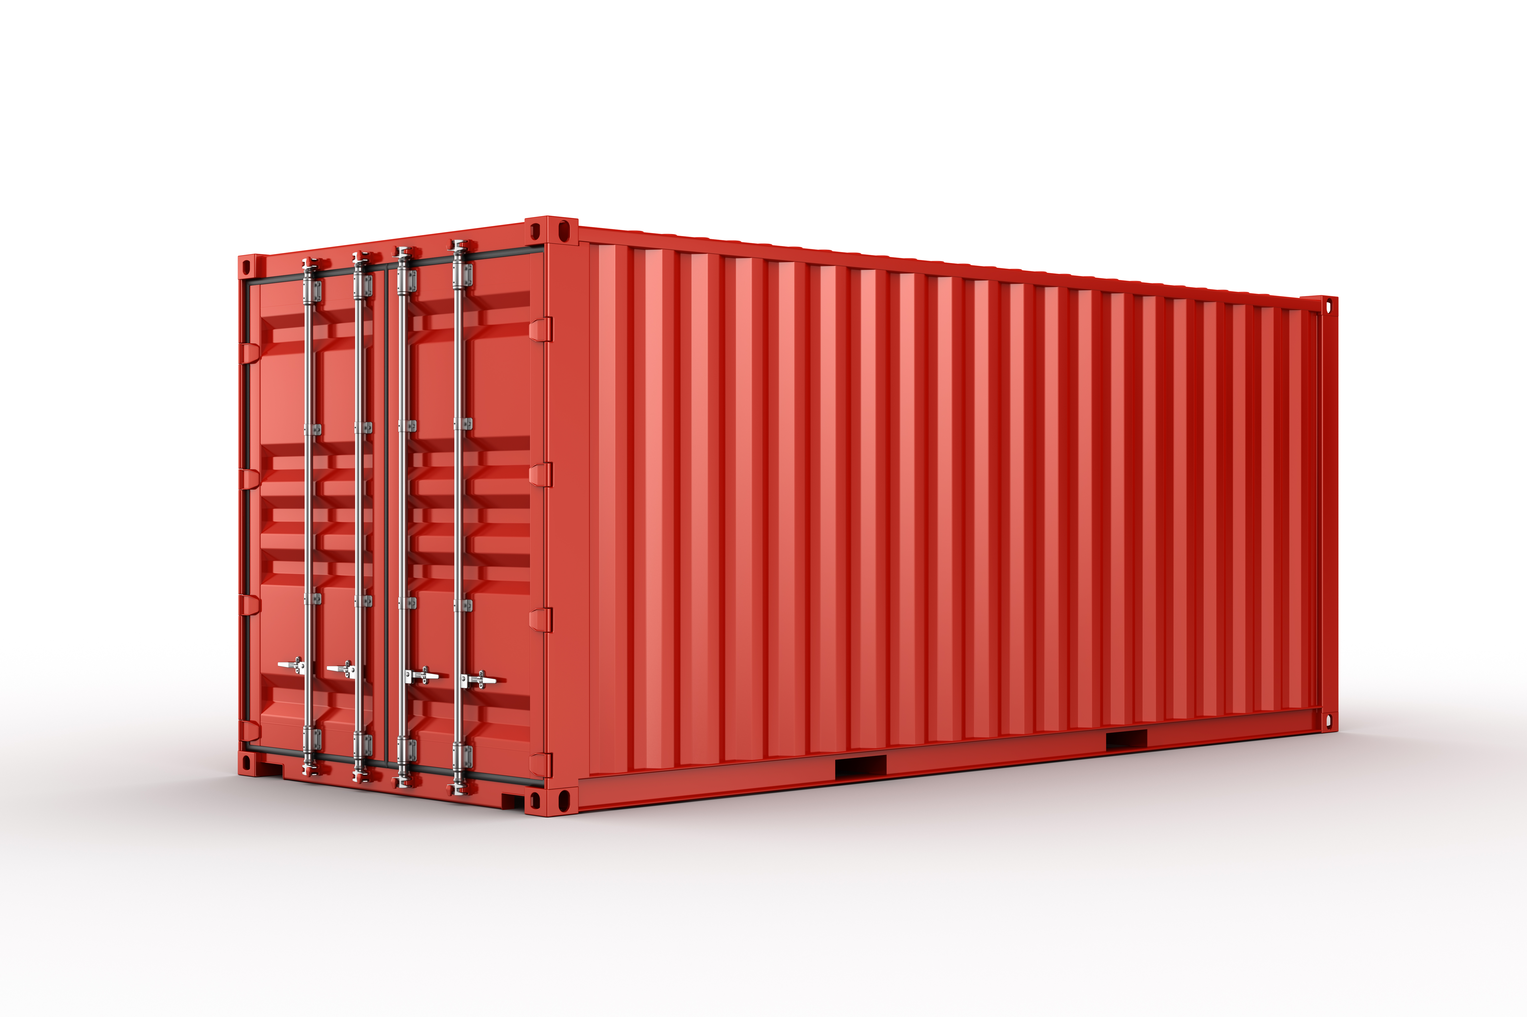


Docker Architecture
Client
Docker_Host
Registry
docker build
Docker Daemon
docker pull
Containers
Images
docker run
Notes:
Explain the core architecture. As we go forward explain the relations between each component.

Slide 25
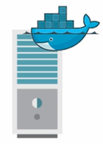
Docker Daemon
The Docker daemon runs on a host machine.
The user uses the Docker client to interact with the daemon.
Why Use Docker Daemon?
Responsible for creating, running, and monitoring containers
Building and storing images

Slide 26
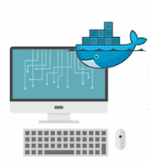
Docker Client
The Docker client is the primary user interface to Docker.
It accepts commands and configuration flags and communicates with a Docker daemon via HTTP.
One client can even communicate with multiple unrelated daemons.
Why Use Docker Daemon?
Since all communication has to be done over HTTP - it is easy connect to remote Docker
The API used for communication with daemon allows developers to write programs that interface directly with the daemon, without using Docker

Slide 27
Docker Registry
Docker Registry is a storage component for Docker Images
We can store the Images in either Public / Private repositories
Docker Hub is Docker’s very own cloud repository
Why Use Docker Registries?
Control where your images are being stored
Integrate image storage with your in-house development workflow

Slide 28
Private or Public Registry?
When choosing between these, some points to consider are:
Performance, depending mainly on roll-out frequency and cluster size.
Security issues such as access control and digitally signing Docker image.
With a private registry, you
Are in full control.
No external dependencies in the CD pipeline, so your build really do build faster (or appear to be faster).
Have to manage storage yourself – and this can increase drastically as the adoption of Devops and number of build increase.
Before doing any decisions,
Evaluate how many builds/images are being pushed and the average increase in size.
Also factor in growth rates for your applications/builds
These will give you metrices for determining network bandwidth and storage requirements.

Slide 29
Which Public Registry?
Factors for making a selection include:
Costs for storage and support for number of images
Workflow support including integration with your version control system
Some of them like Coreos Quay.IO fully support integration with GIT.
You should not have to drastically change your workflow to support external registries.

Slide 30

Docker Images & Containers
run
Docker Images
Docker Containers
Read Only Template Used To Create Containers
Built By Docker Users
Stored In Docker Hub Or Your Local Registry
Isolated Application Platform
Contains Everything Needed To Run The Application
Built From One Or More Images

Slide 31
Docker Architecture In Action
Client
Docker_Host
Registry
docker build
Docker Daemon
docker pull
Containers
Images
docker run
build

Slide 32
Docker Architecture In Action
Client
Docker_Host
Registry
docker build
Docker Daemon
docker pull
Containers
Images
docker run
build
pull

Slide 33
Docker Architecture In Action
Client
Docker_Host
Registry
docker build
Docker Daemon
docker pull
Containers
Images
docker run
build
pull
run

Slide 34
Docker’s Plugins And Plumbing

Slide 35

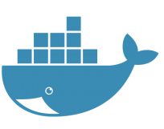
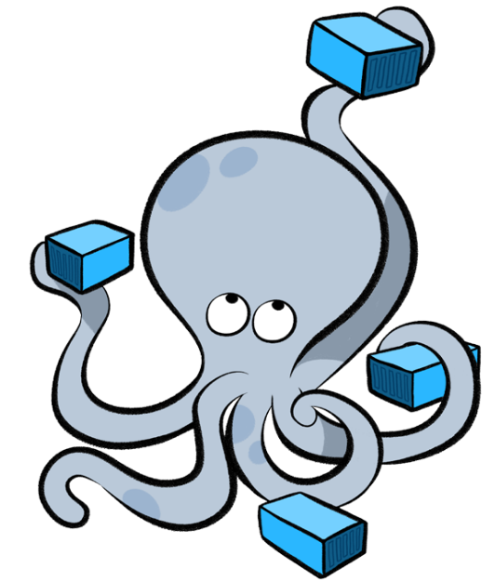

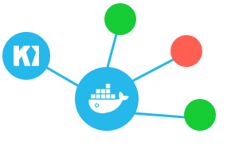
Docker - Plugin’s And Plumbing
The Docker engine and the Docker Hub do not in-and-of themselves constitute a complete solution for working with containers
Docker API
API level allowing components to hook into the Docker Engine
Docker Compose
Tool for building and running applications composed of multiple Docker containers
Used in development and testing rather than production
Docker Machine
Installs and configures Docker hosts on local or remote resources
Machine also configures the Docker client, making it easy to swap between environments
Docker Kitematic
Kitematic is a Mac OS and Windows GUI for running and managing Docker containers

Slide 36
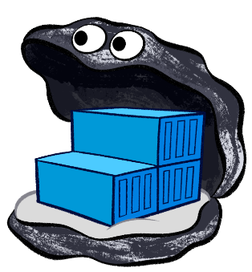
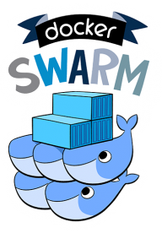
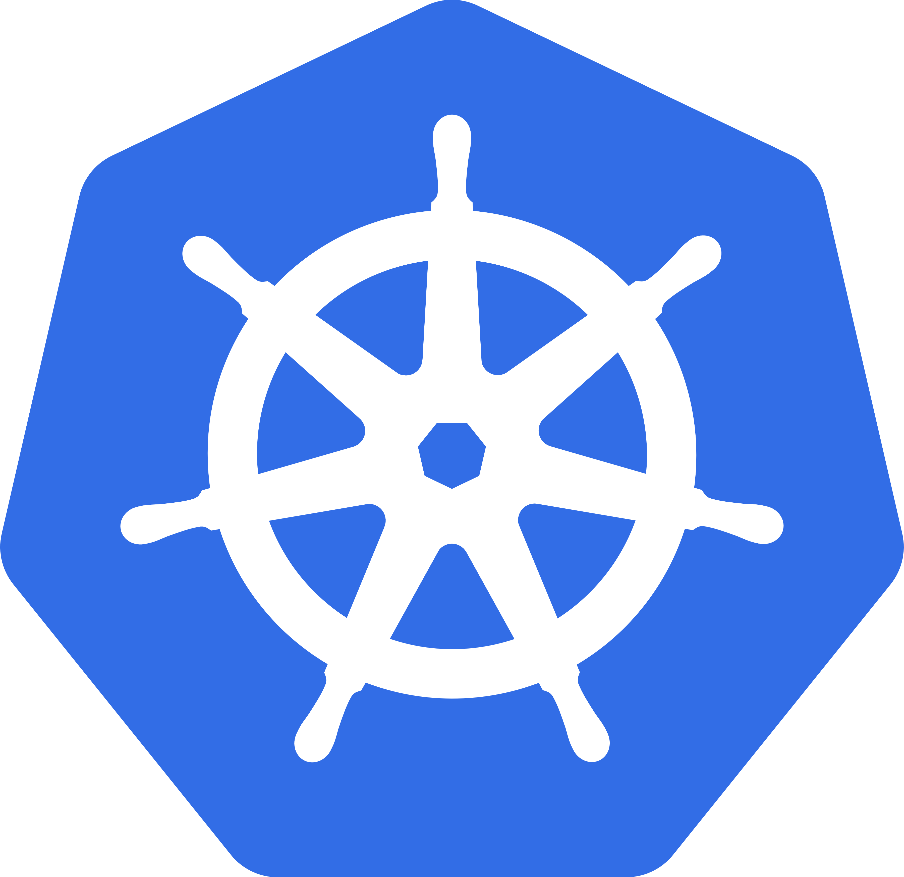
Docker - Plugin’s And Plumbing
Docker Trusted Registry
Docker’s on premise solution for storing and managing Docker images
A local version of Docker Hub that can integrate with an existing security infrastructure and helps organizations comply with regulations regarding the storage and security of data
Only non–open source product from Docker Inc.
Docker Swarm – Docker’s Clustering Solution
Used to group several Docker hosts, allowing the user to treat them as a unified resource
Orchestration and cluster management
In large container deployments, tooling is essential in order to monitor and manage the system
Each new container needs to be placed on a host, monitored, and updated
The system needs to respond to failures or changes in load by moving, starting, or stopping containers appropriately.
Several competing solutions in the area, including Kubernetes from Google

Slide 37
Docker Topics

Slide 38
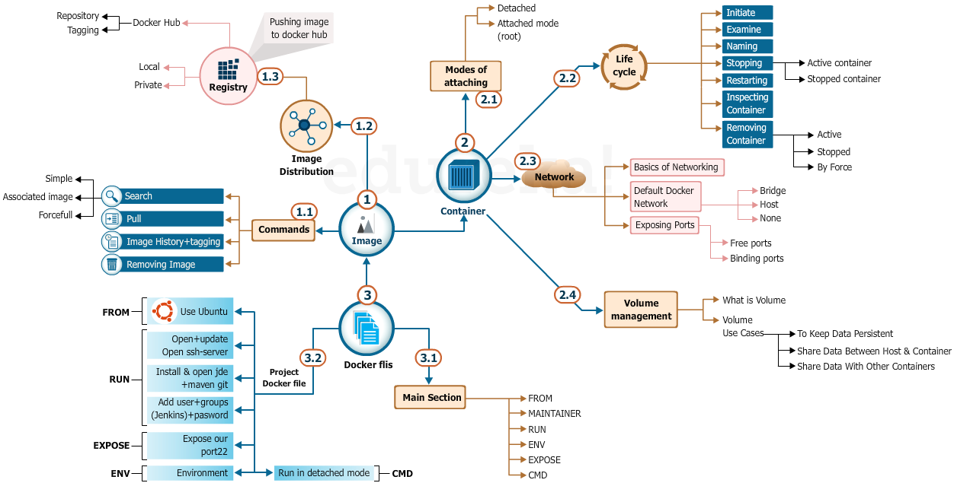
Docker Topics

Slide 39
Working with Docker Images

Slide 40
What is an Image?
An image is basically a text file with a set of pre-written commands and saved as a file usually called as a Docker file
Docker images are made up of multiple layers which are read-only filesystem
A layer is created for each instruction in a Docker file and sits on top of the previous layers
When an image is turned into a container the Docker engine takes the image and adds a read-write filesystem on top (as well as initializing various settings such as the IP address, name, ID, and resource limits)
Docker File
Image
Container

Slide 41
Few Basic Commands
Few Basic Commands:
$ docker help :- Displays all the useful commands for Docker and other general help commands
$ docker images :- Displays a list of existing images in Docker system. It also displays the following details:
REPOSITORY: Name of the repository
TAG: Every image has an attached tag.
IMAGE ID: Each image is assigned a unique ID
CREATED: The date when the image was created
SIZE: The size of the image

Slide 42
Few Basic Commands
$ docker ps :- Displays the list of active containers. It also displays the following details:
CONTAINER ID: Each container is assigned a unique ID
IMAGE: Every image has an attached tag.
COMMAND: Each image is assigned a unique ID
CREATED : The date when the image was created
STATUS: This shows whether the container is active or not
PORTS: The number of exposed ports (needed for networking)
NAMES: Name of container which is automatically assigned by Docker. It contains first name, “_” and last name
$ docker ps – a :- Displays the list of all the container processes which are running or have run in the past

Slide 43
Create Our First Image: Hello-World
The following actions will be performed to pull the image:
Search for images which start with “hello” word from Docker hub
Select the image which we are going to pull
Pull the selected image from Docker Hub
Search for the copy of the image in our local repository
Initiate a container based on “Hello-world” image
Examine container Details

Slide 44
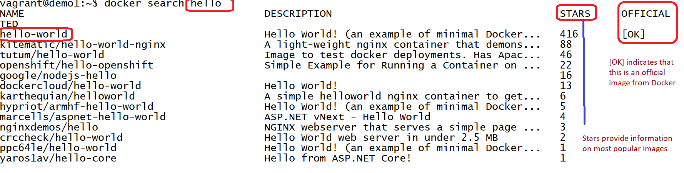
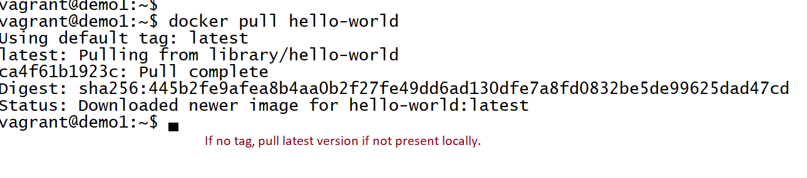
Search – Hello World
Command: $ docker search hello
Command: $ docker pull hello-world

Slide 45
Image Pull – Hello World
Command: $ docker images
Result Details:
REPOSITORY: This is our local repository
TAG: Since we did not specify the Tag in our command, we got the latest version
IMAGE ID: This is the ID of the image
CREATED: This is the time when the image was created
SIZE: This is the size of the image

Slide 46
Image History
Image History:
Can get the history of the base image to understand how the base image was built
Can see the different layers that were used during the build of image
Gives ImageID, command that created particular layer and the size of the layer
Command: $ docker history ImageName

Slide 47
Image History – Why
Psychologically users tend to use the latest images. But sometimes we may need to use older images for following reasons.
Supporting clients who have not yet been migrated to newer technologies. Assume Client A is requiring Library Version 1.0 which was released around January 2013. An image built around this time is more likely to be supporting Library Version 1.0
History also allows to see if a particular images (esp. from a 3rd party) is even under active development/support.
As an example, if an image was last built in January 2012, it is unlikely we will consider this as a base image for our development.

Slide 48
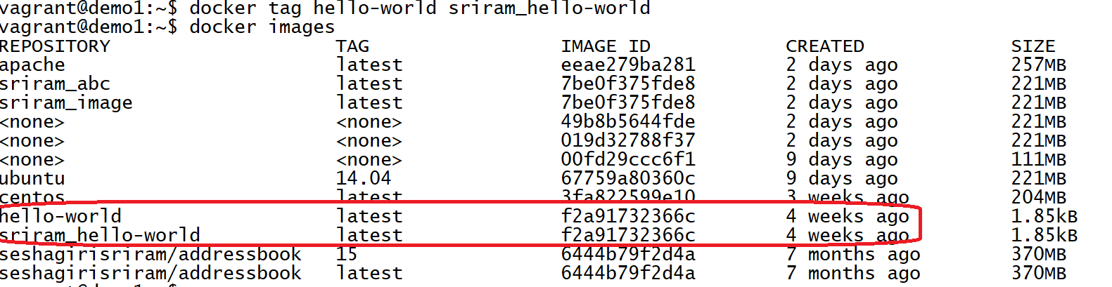
Tagging
Tagging:
Each image has a default tag associated with it
Default tag is set by the image maintainer
Command: $docker tag centos (Image ID or Image Name) Tag (Name of the desired tag)

Slide 49
Tagging – Types and best Practices
Docker uses the term tagging to refer to a label applied to an image (e.g. –t) or refer to string applied to end of image name (e.g. jenkins:latest). The latter is usually referred to as a version tag.
For version tags, there are really no clear cut best practices
Usually practices for versioning in GIT are applied as is to docker tagging also.
Docker’s automated builds lets a user link a “version tag” to either to a branch or a tag in the git history.
A “branch” in this case can refer either to a different git branch or merely a different sub-directory.
Matching to a Git tag provides the most clear-cut use of the docker version-tag; providing a relatively static version stable link. (Food for thought: Is this a good practice or not?)
Using the version tag to indicate any other difference is a widespread practice but with no clear use case except for supporting multiple dockerfiles in same repository.

Slide 50
Image Distribution - Repositories
What is a Repository?
A collection of images.
There can be three kinds of repositories
Local: Can be saved on the system. All the images which are pulled from Public or Private repository gets saved on the local repository
Private:
Can get one free from Docker
If you need other private repositories then you need to pay
Requires Username and Password
Public (Docker Hub):
Need to sign up. We will be discussing this in detail

Slide 51
Hierarchy For Image Storing
There is a hierarchical system for storing images, where following terminology is used:
Image Storing:
Registry
A service responsible for hosting and distributing images. The default registry is the Docker Hub.
Repository
A collection of related images (usually providing different versions of the same application or service)
Tag
An alphanumeric identifier attached to images within a repository (e.g., 14.04 or stable)

Slide 52
Best practices for Image Storing
As far as possible, use namespaces (We will be dealing with namespaces later on)
Version tags as far as possible should be mapped to GIT branching tags and not used for indicating other differences.
Clearly indicate for personal images, the use case for the image e.g. dev, qa, production.
Assume you are the person responsible for pushing images to the repository. Automate the process of pushing images to the repository, which involves:
Push images
Remove images locally
Repull images (Sounds close enough to GIT Best Practices?)

Slide 53
Pushing Images to Docker Hub
Step 1: To push the images to Docker Hub, first login to Docker Hub
Step 2: Create a new public repository with your name
Step 3: Make sure your local image’s name is the same as Docker repo’s name
Step 4: If it is not the same, tag your local image to give it the same repo name as the repository you created on Docker Hub using the command: $ docker tag <Local image name> <Docker Hub repo name>
Step 4: Now, to push the Image to Docker Hub, use the command: $ docker push <Docker Hub repo name>

Slide 54
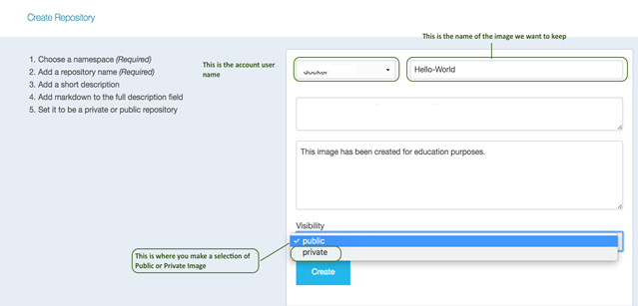
Pushing Images to Docker Hub(Contd..)

Slide 55
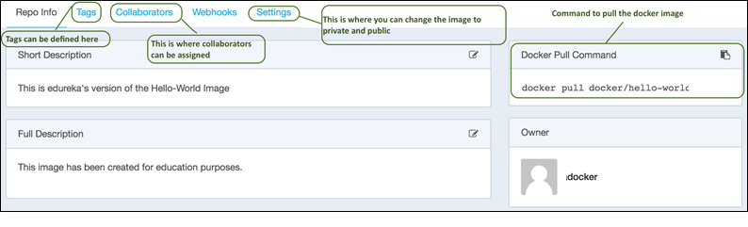
Pushing Images to Docker Hub(Contd..)

Slide 56
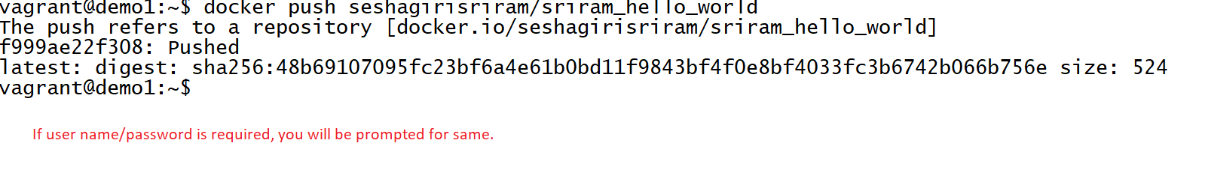
Pushing Images to Docker Hub(Contd..)
Image is pushed to Docker hub using command: $ docker push seshagirisriram(username)/sriram_hello_world(Name of image)

Slide 57
Image Namespaces
Namespaces:
Namespacing ensures users cannot be confused about where images have come from
Example: If using the Centos image, it is the official image from Docker Hub and not some other registry’s version of Centos image
Following are three namespaces pushed Docker images, which can be identified from the image name:
Names Prefixed With A String:
Names prefixed with a string and /, such as /nginx belong to the “user” namespace
These are images on Docker Hub that have been uploaded by a given user
Example: docker/nginx is the nginx image uploaded by the user docker

Slide 58
Image Namespaces
Simple Names:
Names such as Debian and Ubuntu, with no prefixes or /s, belong to “root” namespace
There are official images for most common software packages, which should be your first port of call when looking for an image to use
Names Prefixed With Hostname or IP:
Names prefixed with a hostname or IP are images hosted on third-party registries (not the Docker Hub)
These include self - hosted registries for organizations, as well as competitors to the Hub, such as quay.io
Example: localhost:5000/wordpress refers to an WordPress image hosted on a local registry

Slide 59
Image Selection – Base Image
Base Images
When creating your own images, you will need to decide which base image to start from
The best-case scenario is that you don’t need to create an image at all you can just use an existing one and mount your configuration files and/or data into it
This is likely to be the case for common application software, such as databases and web servers, where there are official images available
In general, you are better off using an official image than rolling your own

Slide 60
Image Selection – Base Image(Contd..)
Benefits of Using Base Images
You get the benefit of other people’s work and experience in figuring out how best to run the software inside a container
If Base Image Is Not Available
If there is a particular reason an official image doesn’t work for you, consider opening an issue on the parent project, as it is likely others are facing similar problems or know of workarounds.

Slide 61
When to select base image and when to create
Benefits of Using Base Images
You get the benefit of other people’s work and experience in figuring out how best to run the software inside a container
If Base Image Is Not Available
If there is a particular reason an official image doesn’t work for you, consider opening an issue on the parent project, as it is likely others are facing similar problems or know of workarounds.

Slide 62
Containers

Slide 63
What we will cover
Attaching to a container
Container Life Cycle:
Initiating a container
Examining existing containers
Naming a container
Attaching to a container
Stopping a container
Restarting a container
Removing a container
Inspect our existing containers and look for important information

Slide 64
Connection Modes
Container can be connected in the following two modes:
Connection Modes
Detached Mode
Root User Mode

Slide 65
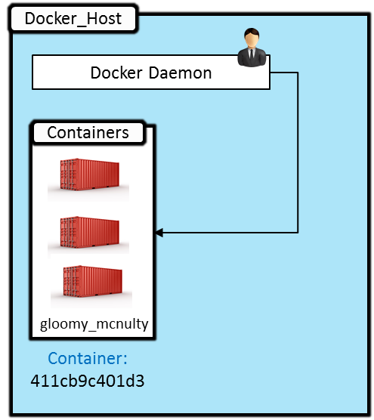
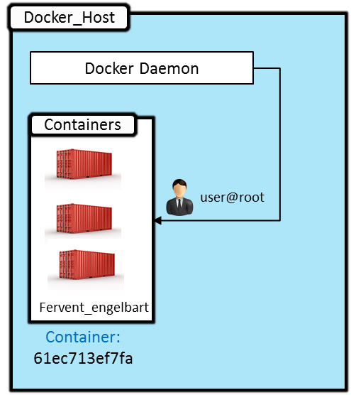
Detached Mode Vs Root Mode
Detached Mode
Command: $ docker run –itd ubuntu:xenial
I – Interactive
T – Connected to terminal
D – Detached mode
Root User Mode
Command: $ docker run –it ubuntu:xenial
I – interactive
T – connected to terminal

Slide 66
Detached Mode Vs Root Mode(Contd..)
Detached Mode
User manages from Daemon
Container does not exit after the process within the container is over.
Container could be stopped at a later stage though.
Using the $docker attach command user can attach as a root user
Allows control over other containers
Root User Mode
User manages from the Root
Container exits after the process within the container is over
Container can be restarted at a later stage though
Using the $docker exit command user can attach to the daemon
Allows control over the container to which user is attached

Slide 67
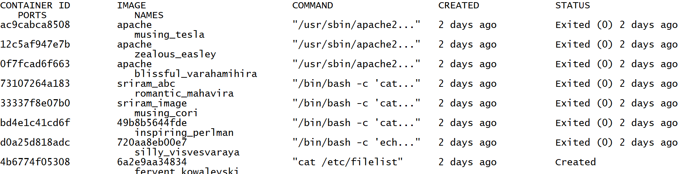
Outputs in connected modes
Command: $ docker ps -a

Slide 68
Selection between Connection Modes
Containers started in detached mode exit when the root process used to run the container exits.
A container in detached mode cannot be automatically removed when it stops.
If this is not your use case and you do wish to automatically remove them, then you would not use the detached mode option.
2 examples that do not use detached mode is the use of Dockers plugins in Jenkins where we want to remove the containers after a Jenkins job is executed. This runs in a root user mode with attaching to the foreground and pretending to be a pseudo terminal and on completion close the container.
Another example will be the starting of a service – where we need to start the service. However, using “service nginx start” with the –d option starts the nginx server but this cannot be used as is since container stops after the command executed.
The detached mode is used when you want to run one off commands and (possibly) have the output of the commands send it outputs to some shared data volume for processing later.

Slide 69
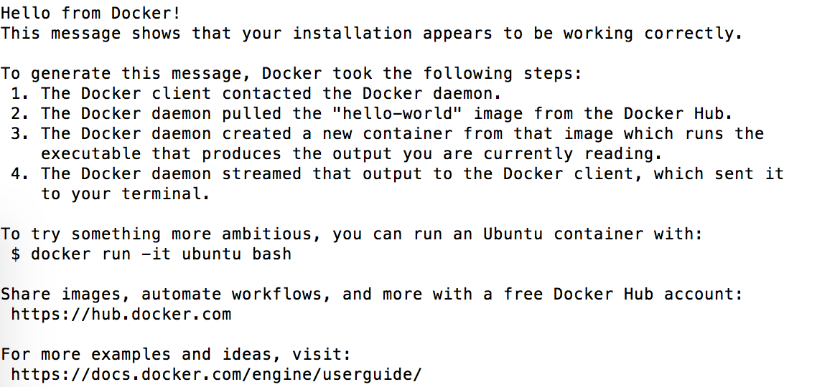
Docker File System - Initiate A Container
Command: docker run hello-world:latest
Container can be initiated using both the “Image name” as well as “Image ID” along with the required tag

Slide 70
Examine Existing Containers
Command: docker ps
Question: What happened to the container we initiated from our image “hello-world?

Slide 71
Examine Existing Containers
Command: docker ps
Question: What happened to the container we initiated from our image “hello-world?
Command: docker ps -a
Display inference:
This container with the name “pedantic_jepsen” , with CONTAINER ID (7a45c308c3fa) ,got created 3 minutes ago from the and exited 3 minutes ago as soon as its processes were executed.

Slide 72
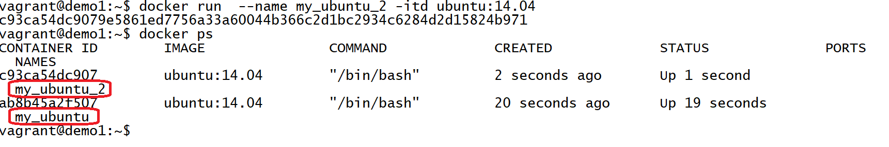
Naming Containers
Docker assigns default names to the container. The usual format would be firstname_secondname.
However Docker gives us the privilege to name our containers. This can be done with the use of the –name command

Slide 73
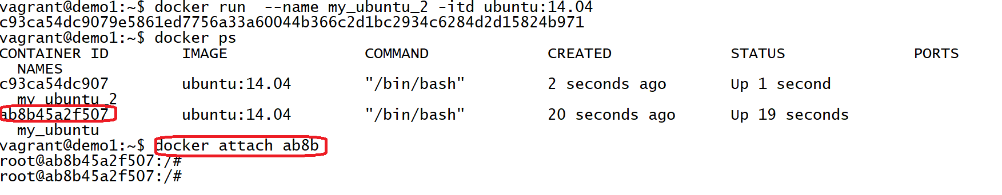
Getting Attached To a Container
When we are running containers in Detached mode (Daemonised Mode) we can still attach to the container if required.
Use the docker attach command to do so.

Slide 74
Stopping a container: Default Mode
When container is initiated in detached mode. It keeps running. It can be stopped in following two ways:
Get attached to the root and exit
Stop the container using the “stop” command
By default a container exists as soon as its processes are executed

Slide 75
Restarting A Container
Start a stopped container by using the “start” command: $ docker start

Slide 76
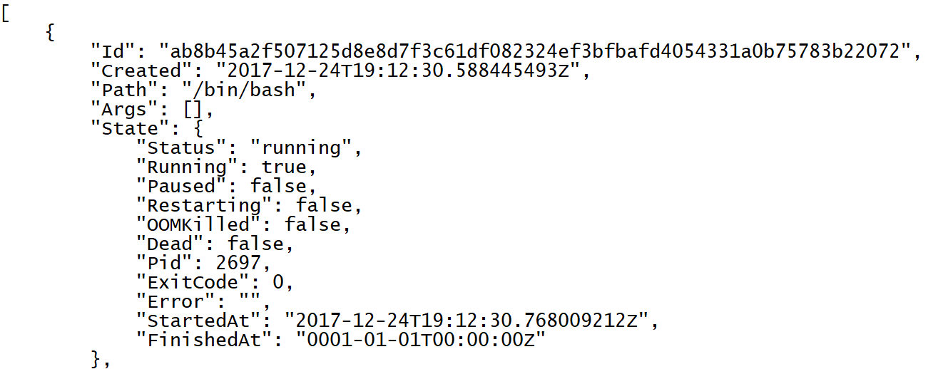
Inspect Containers
Inspect containers and to view important information regarding config, IP address etc. where both the running and stopped containers can be inspected by the command: $ docker inspect

Slide 77
Why would we want to inspect containers?
The basic usage of inspecting containers is
to verify that everything is fine
debug issues (if any)
The inspect command is used to inspect
Containers
Networks
Nodes
……..
The classical usage of these commands are in the Docker Pipeline plugin of Jenkins. This is used to work with Docker Swarm to inspect all nodes in a Swarm that can be used to run the jobs
As a very advanced use case, the output of the docker inspect is used as an input to data visualizers to present your organization with real time data on containers, networks and nodes used in your docker infrastructure.

Slide 78
Removing Images: Use Cases
Removing Images: Use Cases
Use Case 1: Without Associated Containers
Use Case 2: With Associated Containers
Use Case 3: Removing by force
With Associated Containers
Without Associated Containers
Removing by force

Slide 79
Removing Images: With Associated Containers
Removing Images with attached container:
Docker will not allow you to remove an image if there are containers attached with the image
The running containers will have to be removed first and then the image can be removed
Using –f command, the images can be removed forcefully making the associated containers orphan which is not advisable though.
With Associated Containers
Without Associated Containers
Removing by force

Slide 80
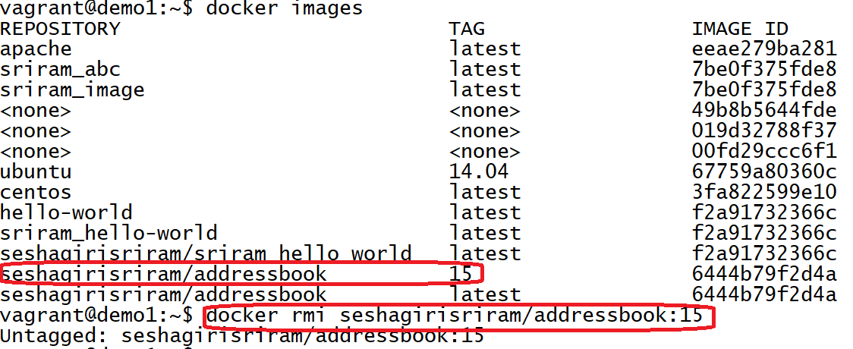
Removing Images: Without Associated Containers
Can use the command: $ docker rmi (Image Name/ID)
With Associated Containers
Without Associated Containers
Removing by force

Slide 81
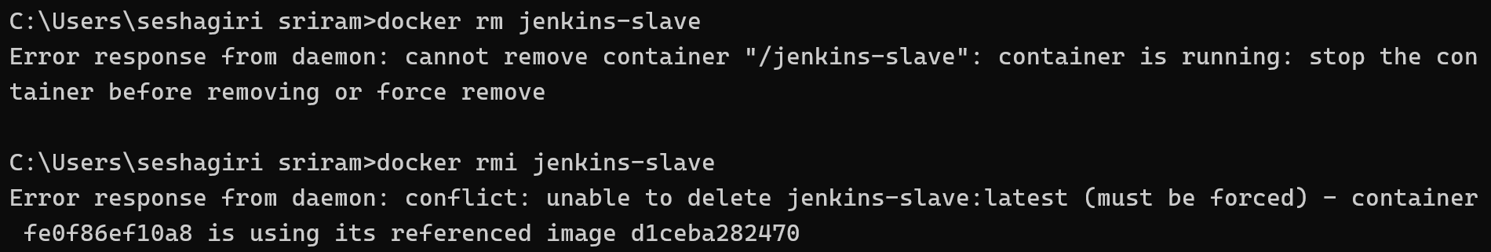
Removing Images: Removing by force
Docker allows to remove images with associated containers forcefully. This is not recommended though.
Can use the –f command to perform this action.
With Associated Containers
Without Associated Containers
Removing by force

Slide 82
When to use remove with –f option?
Use this very rarely and only for images that have containers.
As best practices, containers should be disposed off when they are done.
If this is not possible, you will need to script to dispose of the containers before removing the image.
REITERATED WARNING – use of the –f option is never a good option, unless you know that the image itself warranted removal because of
Poor performance
Security issues

Slide 83
Docker Networking

Slide 84
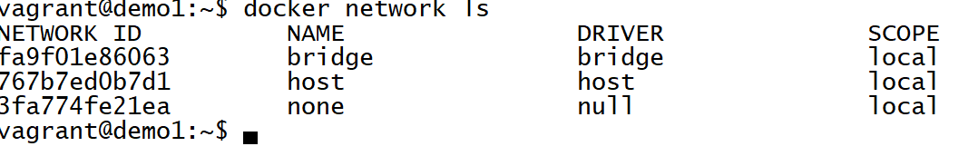
Default Networks
When Docker is installed, it creates three networks automatically, which can be listed using the docker network Command : @docker ls

Slide 85
Default Networks - Types
Bridge Network:
The bridge network represents the docker0 network present in all Docker installations
Docker daemon connects containers to this network by default.
Host Network:
The host network adds a container on the hosts network stack.
You’ll find the network configuration inside the container is identical to the host.
None Network:
The none network adds a container to a container-specific network stack. That container lacks a network interface.

Slide 86
Default Bridge Network Details
With the exception of the bridge network, you really don’t need to interact with these default networks.
While you can list and inspect them, you cannot remove them. They are required by your Docker installation.
Command : $ docker network inspect bridge
The Engine automatically creates a Subnet and Gateway to the network.
Any new containers get added to this network

Slide 87
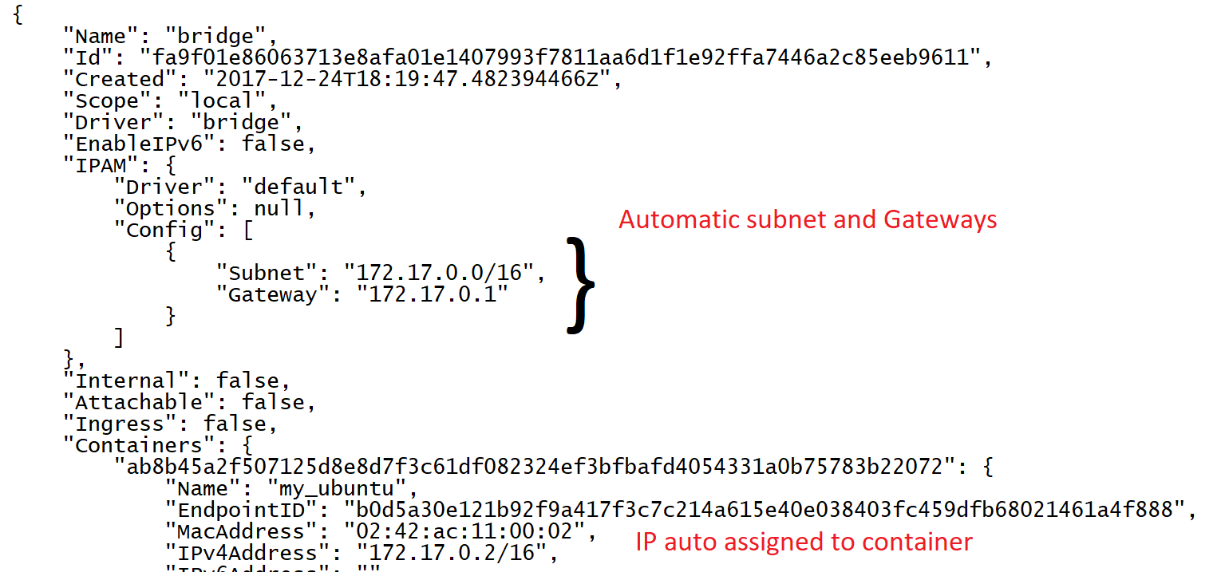
Default Bridge Network Details

Slide 88
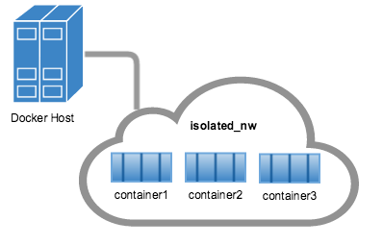
When to use the bridge network?
If you have a set of containers,
each providing micro-services to the other (and)
Should not be exposed to the external world
The bridge network is the best choice.
This is typically used with layered architectures.
Be Aware that services in these containers are not exposed to outside networks.

Slide 89
When to use the user defined bridge network?
Taking the same example from above, if you have an application that needs to expose part of the network and not all, then we use custom bridge networks that expose and publish custom ports.
Again a tiered architecture, where you want to connect to a web application, which in turn connects to backend application or database services is an example of same – which is standard web application deployment practice
A bridge network is useful in cases where you want to run a relatively small network on a single host.
You can, however, create significantly larger networks by creating an overlay network.

Slide 90
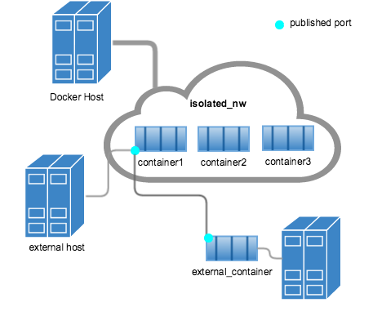
When to use the user defined bridge network?

Slide 91
Exposing Ports
Ports are exposed in the container so that the container can be using the container IP. We can connect to the http address of that port.
We are going to direct the port that is listening to http on a container to an underlying port on our host
We can redirect the exposed ports to the host ports.
There are two ways of exposing the ports – by commands: P or p
P: Any ports that are exposed by the container, any random port between 32768 and 65000 will be available on the host machine. This is the ports available for Docker to pick randomly
The available ports can be seen in different ways
Command to connect to a container: $ docker run – d – name = nginx – P nginx:latest

Slide 92
Exposing Ports(Contd..)
Two ways to connect to a container:
Connect if IP Address is known and I am on the host machine
I am on the network of my host machine and the IP address and port of the container.
It can also be obtainer through Docker port command : $ docker port nginx-demo $CONTAINERPORT

Slide 93
Exposing Ports: Use Case
Exposing Ports
Free Ports
Binding Ports

Slide 94
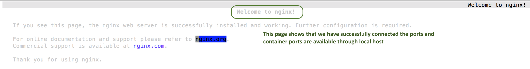
Connection Through Host Port

Slide 95
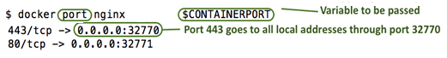
Getting Ports – Binding Ports
What if I want to bind it to a specific port on my server rather than any value which is picked in a range $ docker run –d –p 8080:80

Slide 96
Free or Binding ports?
It is generally preferred to use binding ports esp. for services that are external facing and do not need to change e.g. a web server needs to be exposed on port 80.
It is also used (indirectly) as a proxy so that end users do no need to remember non-standard ports like 8081 (Technically firewall rules do not need to be tweaked much).

Slide 97
Docker Volumes

Slide 98
Docker - Volumes
Volumes are files or directories that are directly mounted on the host and not part of the normal union file system
Docker filesystems are temporary by default
You can create, modify, and delete files as you wish
If container is stopped and restarted, all the changes will be lost: any files you previously deleted will now be back, and any new files or edits you made won't be present
Docker Data Volumes allow you to store data in separate place which can then be used as a normal folder - all changes are persistent
Command: docker run –ti –v /hostLog:/log ubuntu
Run second container, where volume can be shared: docker run –ti --volumes-from firstContainerName ubuntu

Slide 99
Volumes – Use Cases
Docker Data Volumes: Use Case
Use Case 1: To keep data around, even through container restarts
Use Case 2: To share data between the host filesystem and the Docker container
Use Case 3: To share data with other Docker containers
To Keep Data Persistent
Share Data Between Host and Container
Share Data With Other Containers

Slide 100
Volumes – Use Cases
There's no way to directly create a "data volume" in Docker - Instead create a data volume container with a volume attached to it. For any containers to connect to the data volume container, need to use the Docker's –volumes from option to grab the volume from this container and apply them to the current container
Commands:
# Create the data volume Container
docker create -v /tmp --name datacontainer Ubuntu
# The above creates a container called data container in the directory /tmp.
# use it..
docker run -t -i --volumes-from datacontainer ubuntu /bin/bash
# from now on any data written to /tmp is persisted
To Keep Data Persistent
Share Data Between Host and Container
Share Data With Other Containers

Slide 101
Volumes – Use Cases
Example:
docker run -d -v ~/nginxlogs:/var/log/nginx -p 5000:80 -i nginx
In above example, folder ~/nginxlogs on host machine is mapped to /var/log/nginx
Writes to /var/log/nginx in container will be reflected to ~/nginxlogs on host
Similarly writes to ~/nginxlogs on host will be reflected back to /var/log/nginx on container
To Keep Data Persistent
Share Data Between Host and Container
Share Data With Other Containers

Slide 102
Volumes – Use Cases
In addition to mounting a host directory in your container, some Docker volume plugins allow you to provision and mount shared storage, such as iSCSI, NFS, or FC.
A benefit of using shared volumes is that they are host-independent.
A volume can be made available on any host that a container is started on as long as it has access to the shared storage backend, and has the plugin installed.
The –volumes-from option is used to share information between services.
To Keep Data Persistent
Share Data Between Host and Container
Share Data With Other Containers

Slide 103
Volumes – Use Cases
Other Commands:
# Example of using flocker
docker run -d -P --volume-driver=flocker -v my-named-volume:/webapp --name web training/webapp python app.py
# (or) Create a volume
docker volume create -d flocker -o size=20GB my-named-volume # use it..
docker run -d -P -v my-named-volume:/webapp --name web training/webapp python app.py
To Keep Data Persistent
Share Data Between Host and Container
Share Data With Other Containers

Slide 104
Which is the best way?
Mounting host directories is usually used.
Any write inconsistencies have to be managed by applications themselves – not DOCKER.
For larger data volumes, docker has plugins to manage NFS or other shared storage volumes.
The factors determining which ones to choose will depend on
Your volume requirements
Cost of solution

Slide 105
Docker Files

Slide 106
Docker File
Docker file is the basic building block of Docker containers
Docker file is a file with a set of instructions written in it. It forms the basis for any image in Docker.
Almost every time any base image is going to based upon another image. You are going to pick up a base image and build up on that image.

Slide 107
Docker File – Creation Steps
Step 1: Create Directory
Step 2: Create a named file subdirectory directory
Step 3: Input the set of instructions
Step 4: Save the file
Step 5: Build the image

Slide 108
Docker File Main Sections
Following are the main sections of the Docker file:
FROM and MANINTAINER
How to RUN commands
How to set up ENV (environments)
Difference between CMD vs RUN
How to EXPOSE ports

Slide 109
Docker File – FROM and MAINTAINER
FROM:
Every Docker file starts with this command
It shows where is the base image coming from
Will pick up an image from Docker hub or some other repository and make some changes for ex: environmental changes, or expose your ports etc. and then save the file.
Example: FROM debian:stable

Slide 110
Docker File – FROM and MAINTAINER
MAINTAINER:
The section of the Docker file shows the maintainer or the owner of the Docker file
It requires certain format – It requires the name and the email id
Following is the format
MAINTAINER name <emailid >
FROM debian:stable
MAINTAINER docker<sriram@gmail.com >

Slide 111
Docker File – RUN
RUN:
Set of actions you want to perform on the base image, where the modification of the base image starts.
These actions have to be performed with root images
Commands will be executed in the exact way you write it
Example:
FROM debian:stable
MAINTAINER docker<sriram@gmail.com >
RUN apt –get update
RUN apt –get upgrade

Slide 112
Docker File – RUN(Contd..)
RUN:
Following steps will happen when you save this file and build an image
Step 1: It is going to pull the Debian base image
Step 2: It will set up the MAINTAINER in the container
Step 3: IT will update the packages
Step 4: IT will upgrade the packages

Slide 113
Docker File – ENV
ENV:
Can set up the environment variable
By setting this up we can pass a variable that we need to pass inside the container that runs on base image
Following format is required to set up this directive: ENV MYVALUE -test
When you run the container this value will have to be passed using “echo $MYVALUE”
Example:
FROM debian:stable
MAINTAINER docker<sriram@gmail.com >
RUN apt –get update
RUN apt –get upgrade
ENV MYVALUE -test

Slide 114
Docker File – EXPOSE
EXPOSE:
Command to expose any ports to expose through your container to the underlying host operating system with mapping redirect. We can get to the containers through containers IP’s.
Ports are set up in the Docker file to be exposed.
Following format is required to set up this directive: EXPOSE 80 (Port number which you want to expose)
When you run docker ps for this container you will see the information for the ports which are exposed
Example:
FROM debian:stable
MAINTAINER docker<sriram@gmail.com >
RUN apt –get update
RUN apt –get upgrade
ENV MYVALUE -test
EXPOSE 80
EXPOSE 24

Slide 115
Docker File – CMD
CMD:
Command for starting up of a service of some kind
Anything that is after a command is a list of things to run within any container that is initiated on a base image
All the actions to run when the containers are initiated is described in this section
Following format is required to set up this directive: CMD [“usr/sbin/apache2ctl”]
Example:
FROM debian:stable
MAINTAINER docker<sriram@gmail.com >
RUN apt –get update && apt –get upgrade
ENV MYVALUE -test
EXPOSE 80
EXPOSE 24
CMD [“usr/sbin/apache2ctl”, “-D”, “FOREGROUND”]

Slide 116
Create Docker File - Demo
Step 1: Create a directory called 'custom' and change it. In this directory, create an empty file called ”Dockerfile"
Step 2: Edit ‘Dockerfile’ created in Step #1. This configuration file should be written to perform following actions:
Use base Centos 6 latest version image from public repository
Identify your email address as the author and maintainer of this image
Update the base OS after initial import of the image
Install the Open-SSH Server
Install Apache Web Server
Expose ports 22 and 80 to support the services installed
Step 3: Build custom image from ’Dockerfile' as created above. Name/tag this new image as ”customimg/test:v1". Once the image is built, verify the image appears in your list.

Slide 117
Questions
Should I include my code with COPY/ADD or a volume?
You can add your code to the image using COPY or ADD directive in a Docker file.
This is useful if you need to relocate your code along with the Docker image, for example when you’re sending code to another environment (production, CI, etc.).
Prefer COPY over ADD as image size is reduced with COPY over ADD.
You should use a volume if you want to make changes to your code and see them reflected immediately, for example when you’re developing code and your server supports hot code reloading or live-reload.
There may be cases where you’ll want to use both. You can have the image include the code using a COPY, and use a volume in your Compose file to include the code from the host during development. The volume overrides the directory contents of the image.

Slide 118

Docker Compose

Slide 120




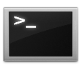






Docker Compose: Multi Container Applications
Without using Compose
Build and run one container at a time
Manually connect containers
Manual Dependency Management
With Compose
Define multi-container apps in a single file
Single command to deploy entire apps
Handles Dependencies
Works with Networking, Volumes, Swarm

Slide 121
Docker Compose: Multi Container Applications
Without using Compose
With Compose
docker run -e MYSQL_ROOT_PASSWORD=<pass> -e MYSQL_DATABASE=wordpress --name wordpressdb -v "$PWD/database":/var/lib/mysql -d mysql:latest
services:
db:
image: mysql:5.7 volumes:
- db_data:/var/lib/mysql environment: MYSQL_ROOT_PASSWORD:
MYSQL_DATABASE: wordpress wordpress:
depends_on:
- db
image: wordpress:latest ports:
- "80:80"
environment: WORDPRESS_DB_PASSWORD=<pass>
docker run -e WORDPRESS_DB_PASSWORD=<pass> --name wordpress --link wordpressdb:mysql -p 80:80 -v "$PWD/html":/var/www/html
-d wordpress

Slide 122
Docker Compose
A tool for defining and running multi- container Docker applications
With Compose, you use a YAML file to configure your application’s services.
Compose works in all environments: production, staging, development, testing, as well as CI workflows.
With a single command, you create and start all the services from your configuration

Slide 123

Docker Compose
Define your app’s environment with a Dockerfile
Define the services that make up your app in Docker Compose file
Run the CLI:
docker-compose up

Slide 124
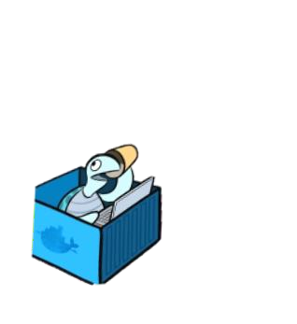

Docker Compose: Multi Container Applications
A
B
C
Services
Volumes
Networking

Slide 125


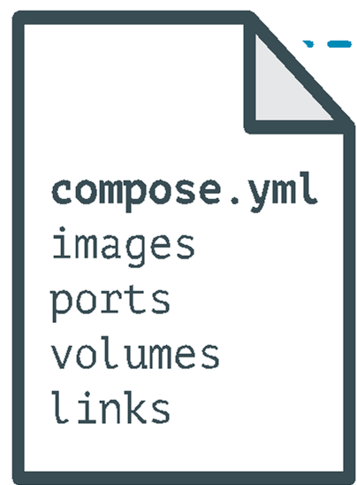
Docker Compose: Multi Container Applications
containers:
web:
build: .
command: python app.py ports:
- "5000:5000"
volumes:
.:/code environment:
PYTHONUNBUFFERED=1
redis:
image: redis:latest
command: redis-server --appendonly yes

Slide 126
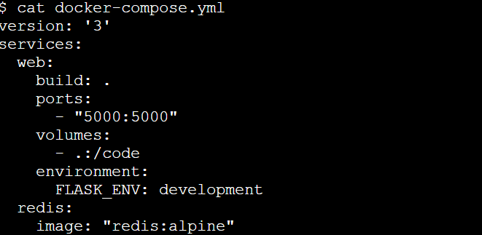
Docker Compose: Multi Container Applications

Slide 127
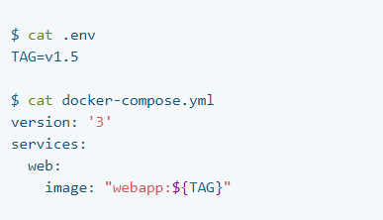
Docker Compose: Multi Container Applications
Using .env file

Slide 128
Docker Compose: Multi Container Applications
Commands:
docker compose up
docker compose down
docker compose run –e DEBUG=1 <services>

Slide 129
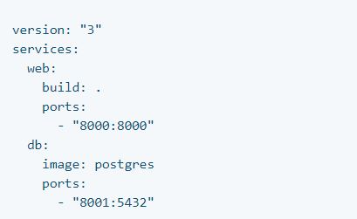
Docker Compose: Multi Container Applications
A network called myapp_default is created.
Name is based on directory
A container is created using web’s configuration.
It joins the network myapp_default under the
name web.
A container is created using db’s configuration.
Joins the network myapp_default under the name db.

Slide 130
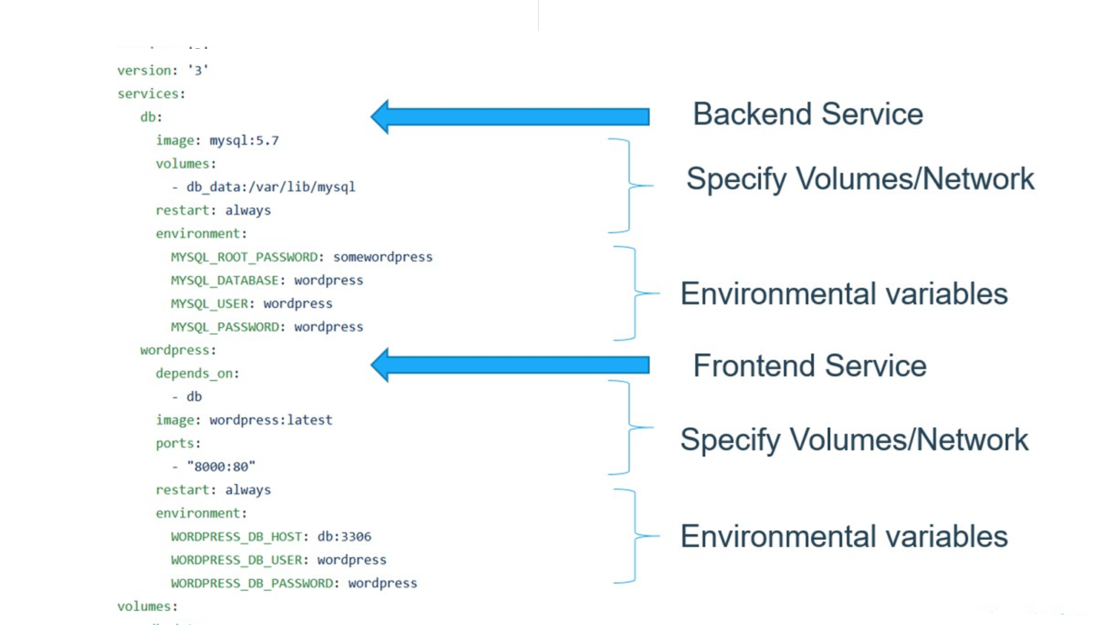
Docker Compose: Multi Container Applications

Slide 131

Q &A

Slide 132
We're done!
Thank you for your time and participation.

